Slide 1
Delving into Northern White Rhino Stem Cells
Conservation Genetics, Beckman Foundation
Ginny Wu

Slide 2

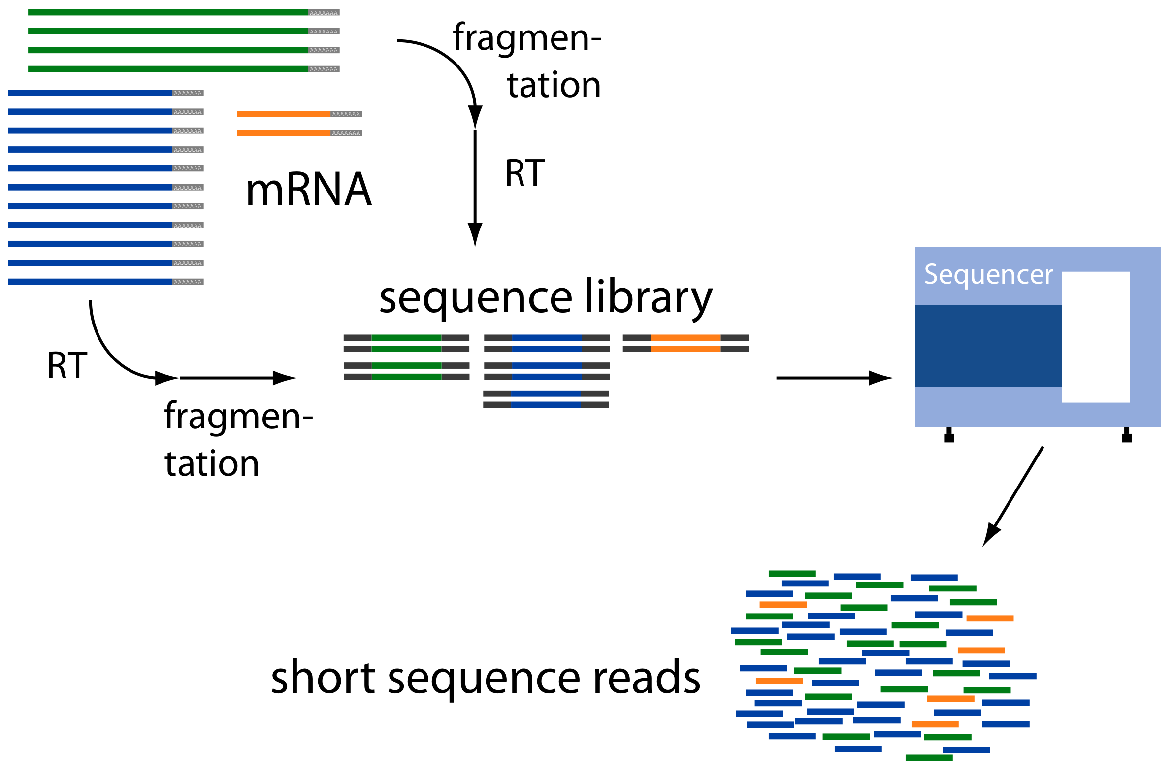
Where are we now?
Generated embryoid bodies (EBs) to test differential ability of NWR iPSCs
iPSCs
D2
Suspension
D4
Suspension
D2
Plated
D4
Plated
D7
Plated
Differentiation
Transcriptome Analysis using RNAseq
Fibroblasts
Sequencing
Analysis pipeline
RNA
iPSCs
Embryoid Bodies
Notes:
Conservation Genetics has reprogrammed iPSCs from 9 indivduals
Test differential potential by generating Ebs,
Aggregates begin to spontaneously differentiate
Dna -> rna TRANSCRIPT → protein
transcriptome = all rna transcripts present in a cell
Varies depending on cell type or environmental conditions
RNAseq takes snapshot of transcriptome in a cell
I was given the data to analysis = find characteristic genes, enriched biological pathways

Slide 3
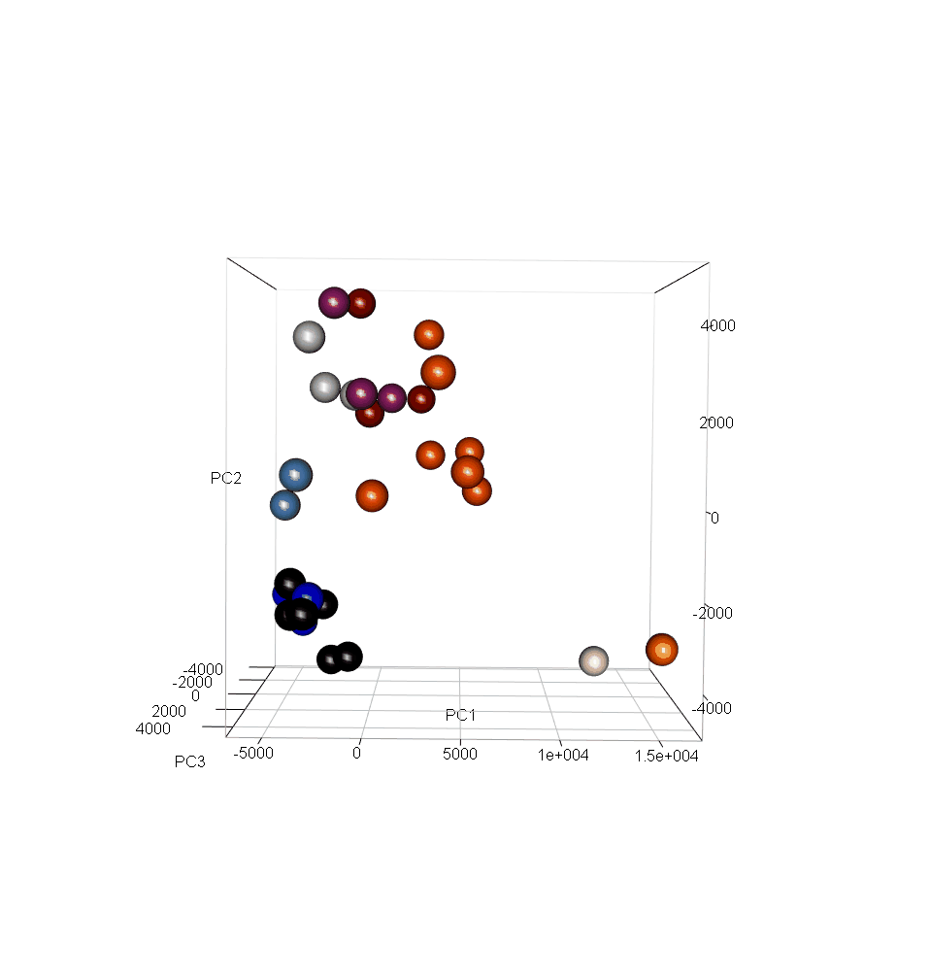
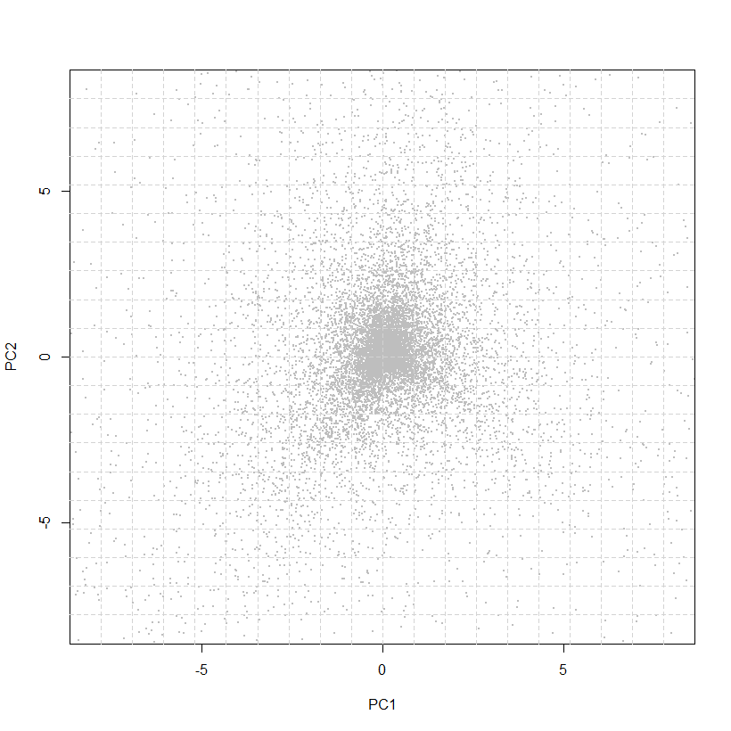
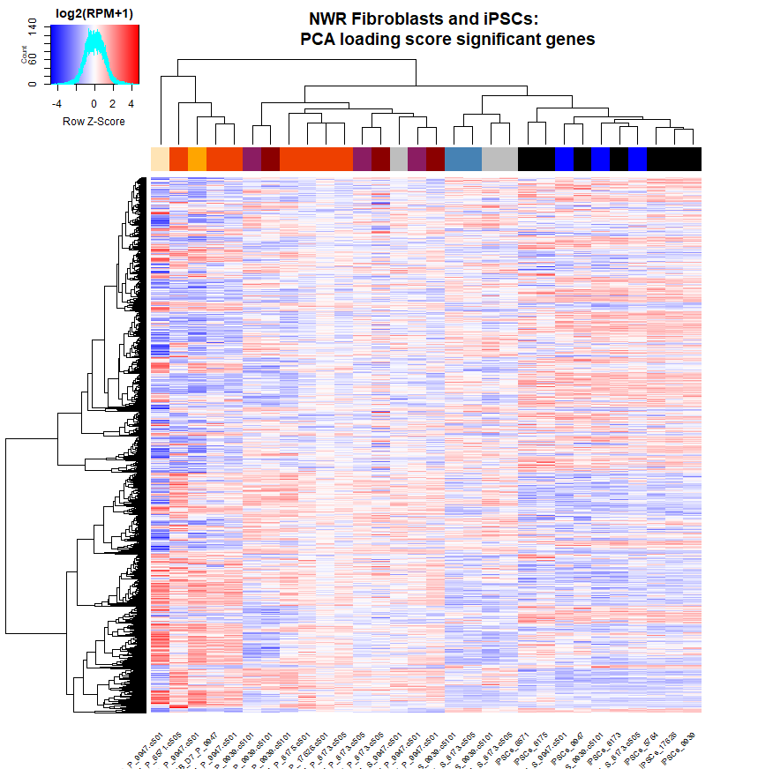
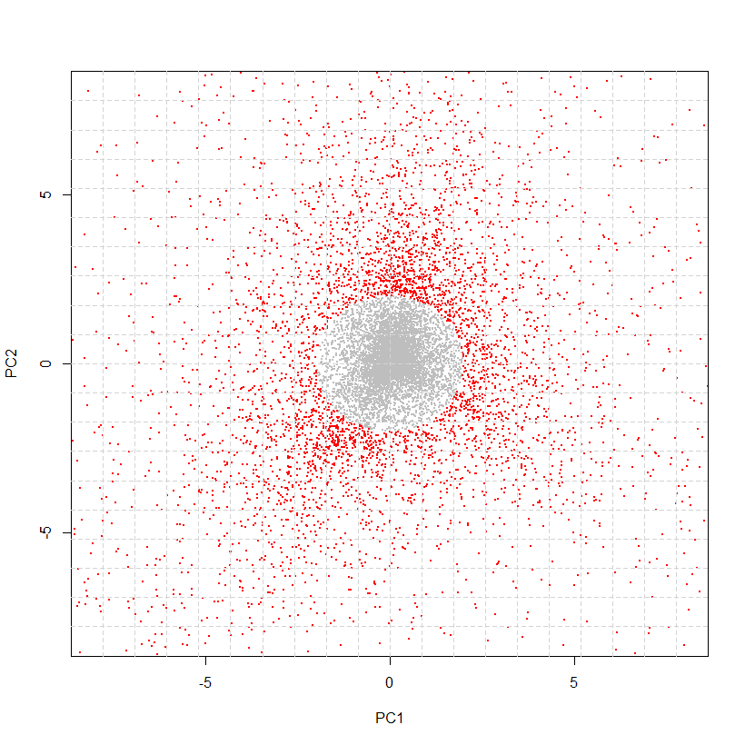
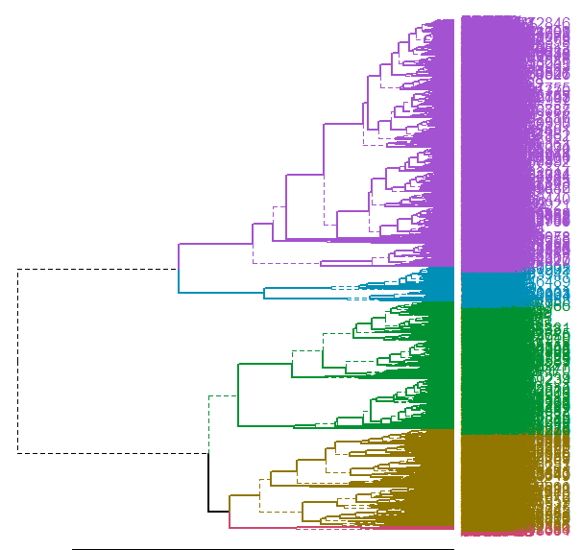
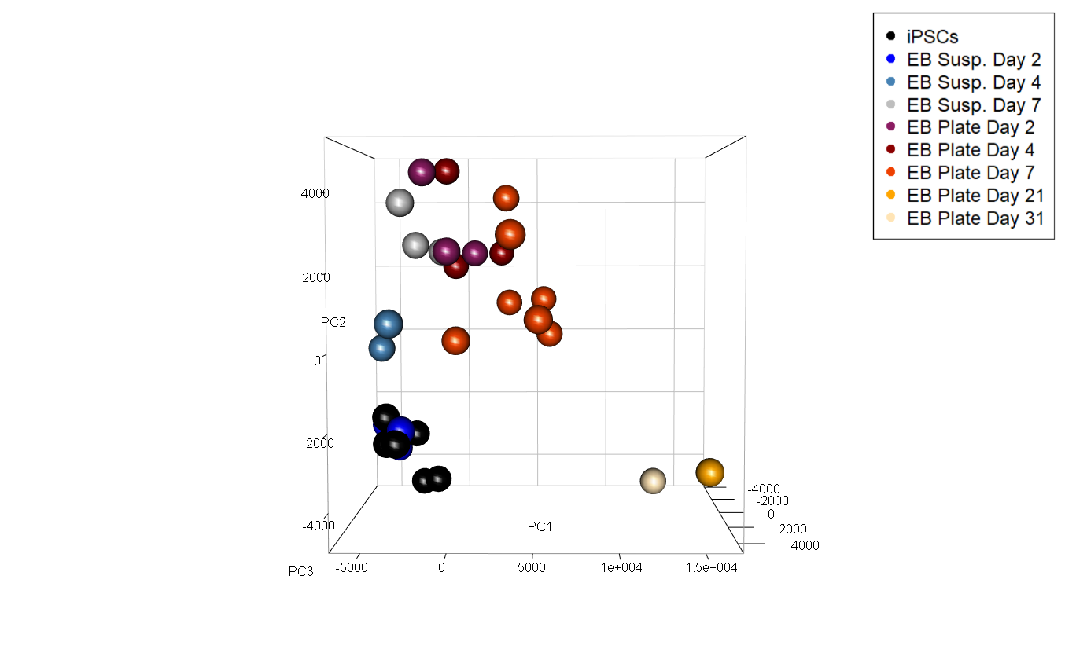

RNAseq Analysis: Differential Expression
RNAseq
raw counts
Principal Component Analysis (PCA)
Gene Loading Score Scatter Plot
Heatmap & Unsupervised
Hierarchical Clustering
Gene Cluster Ontology Analysis
iPSC EB
Data shown from iPSCs and EBs Timepoints experiment
Notes:
The data I show is from our iPSC to EB experiment
PCA:
Closer = similar, farther = dissimilar
The way each sample position is calculated is by giving each gene a score
Since we’re trying to find the most characterizing genes of a cell type, I plotted all gene scores on a scatterplot and selected for those that scored above 2 SD of the overall mean
~6000 genes selected (5948) that are 2 SD above mean for both PC1 and PC2
Expression heatmap of these 6000
Blue is lowly expressed, red is highly expressed
The heatmap clusters them by UHC
Cut dendrogram into 5 clusters for gene ontology analysis
Put in a list of genes → output biological processes associated with that gene, clustered by how relevant they are in your input

Slide 4
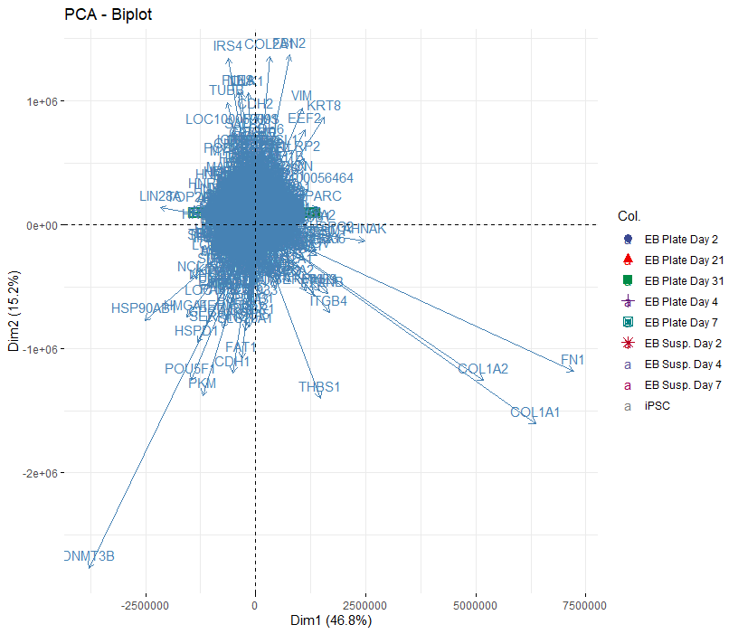
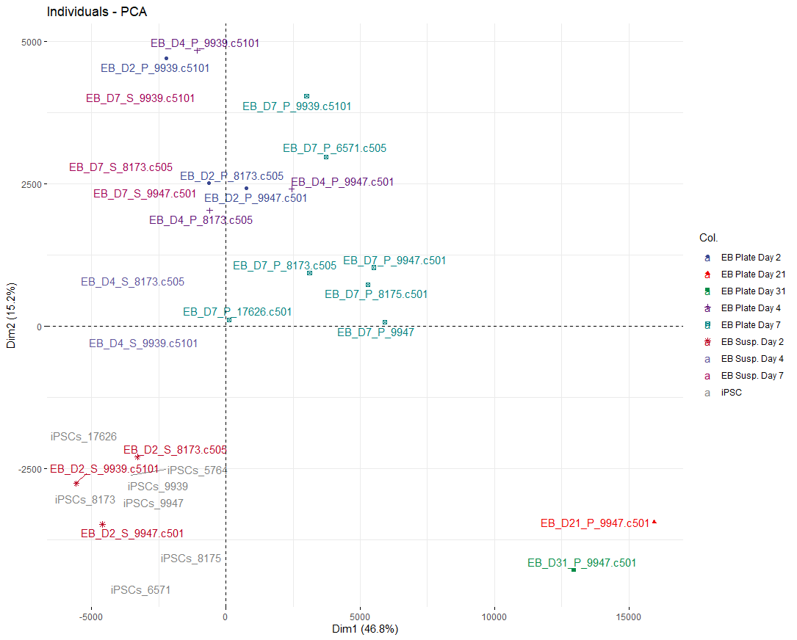
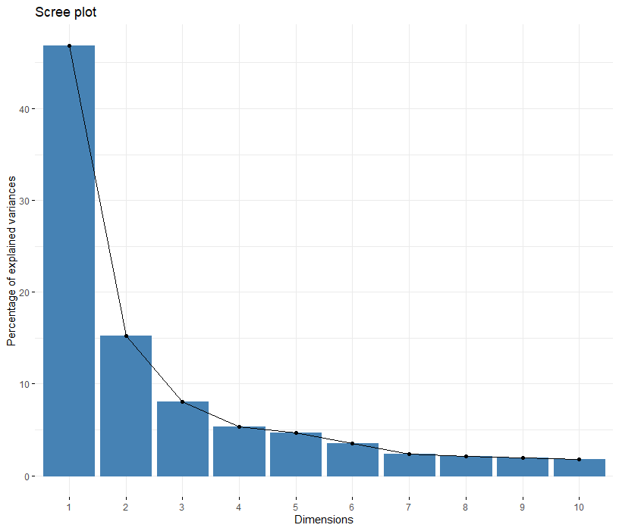
Principal Component Analysis (PCA)
How is a PCA calculated?
For each sample, each gene is scored
Multiplied by RNAseq read count
Plot axes are scaled by top 3 samples
Notes:
The data I show is from our iPSC to EB experiment
PCA:
Closer = similar, farther = dissimilar
The way each sample position is calculated is by giving each gene a score
Since we’re trying to find the most characterizing genes of a cell type, I plotted all gene scores on a scatterplot and selected for those that scored above 2 SD of the overall mean
~6000 genes selected (5948) that are 2 SD above mean for both PC1 and PC2
Expression heatmap of these 6000
Blue is lowly expressed, red is highly expressed
The heatmap clusters them by UHC
Cut dendrogram into 5 clusters for gene ontology analysis
Put in a list of genes → output biological processes associated with that gene, clustered by how relevant they are in your input

Slide 5
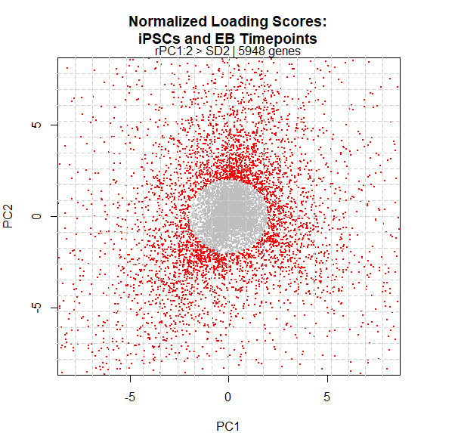
Principal Component Analysis (PCA)
How is a PCA calculated?
For each sample, each gene is scored
Multiplied by RNAseq read count
Plot axes are scaled by top 3 samples
Notes:
The data I show is from our iPSC to EB experiment
PCA:
Closer = similar, farther = dissimilar
The way each sample position is calculated is by giving each gene a score
Since we’re trying to find the most characterizing genes of a cell type, I plotted all gene scores on a scatterplot and selected for those that scored above 2 SD of the overall mean
~6000 genes selected (5948) that are 2 SD above mean for both PC1 and PC2
Expression heatmap of these 6000
Blue is lowly expressed, red is highly expressed
The heatmap clusters them by UHC
Cut dendrogram into 5 clusters for gene ontology analysis
Put in a list of genes → output biological processes associated with that gene, clustered by how relevant they are in your input

Slide 6
Gene Ontology: Biological Process
iPSC EB
iPSCs
Cluster 1:
Mitosis, nuclear division, RNA splicing
EBs
Cluster 2:
RNA Processing,
chromatin and chromosome modification
Cluster 3:
Neuron differentiation, epidermis, ectoderm, and epithelial cell differentiation
Cluster 4:
Sensory organ development, embryonic
organ development, ear development
Cluster 5:
Regulation of cell death,
positive regulation of immune system
Notes:
AN EXAMPLE OF GENE ONTOLOGY ANALYSIS RESULTS
Listed some of the biological processes

Slide 7
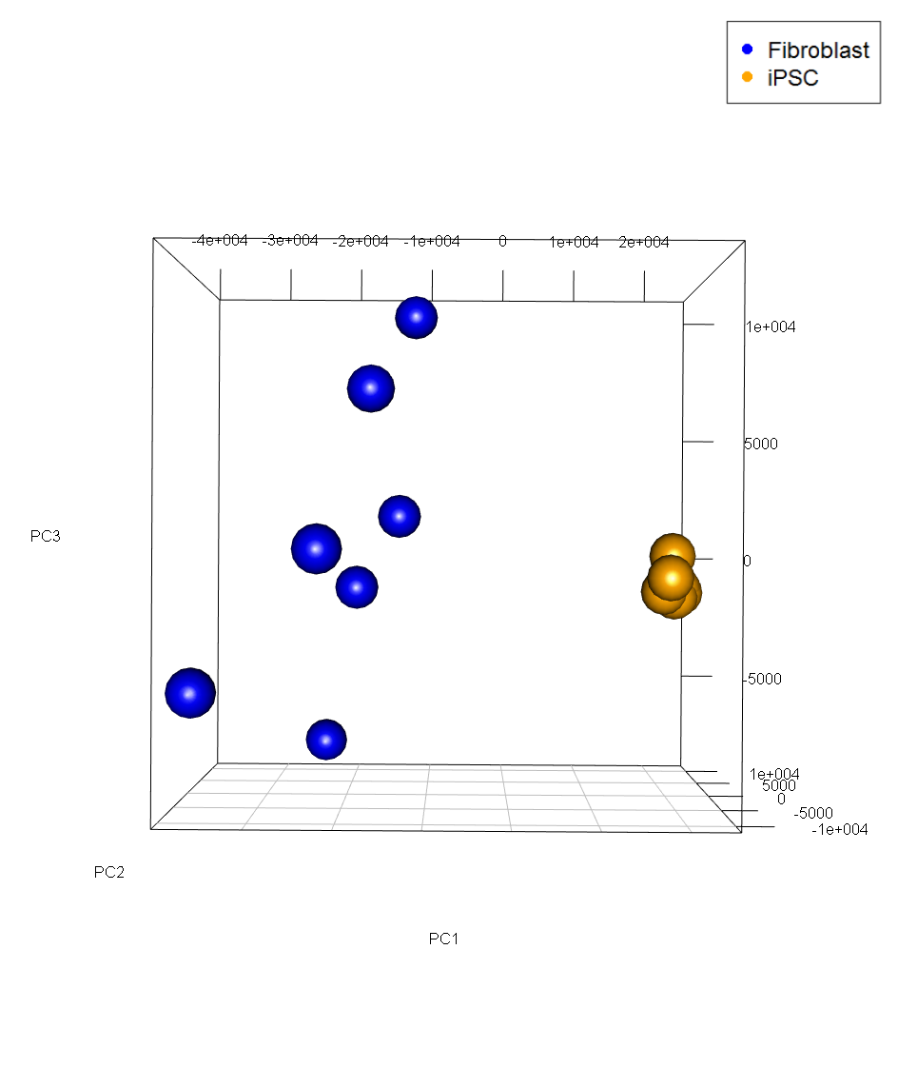
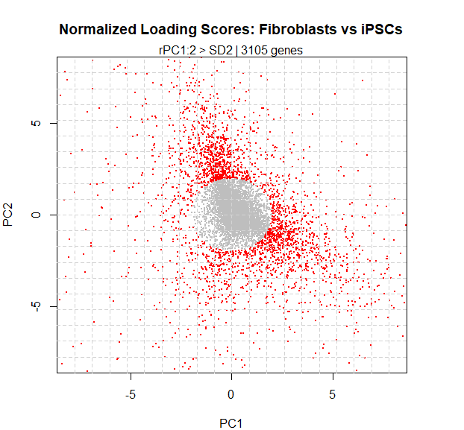
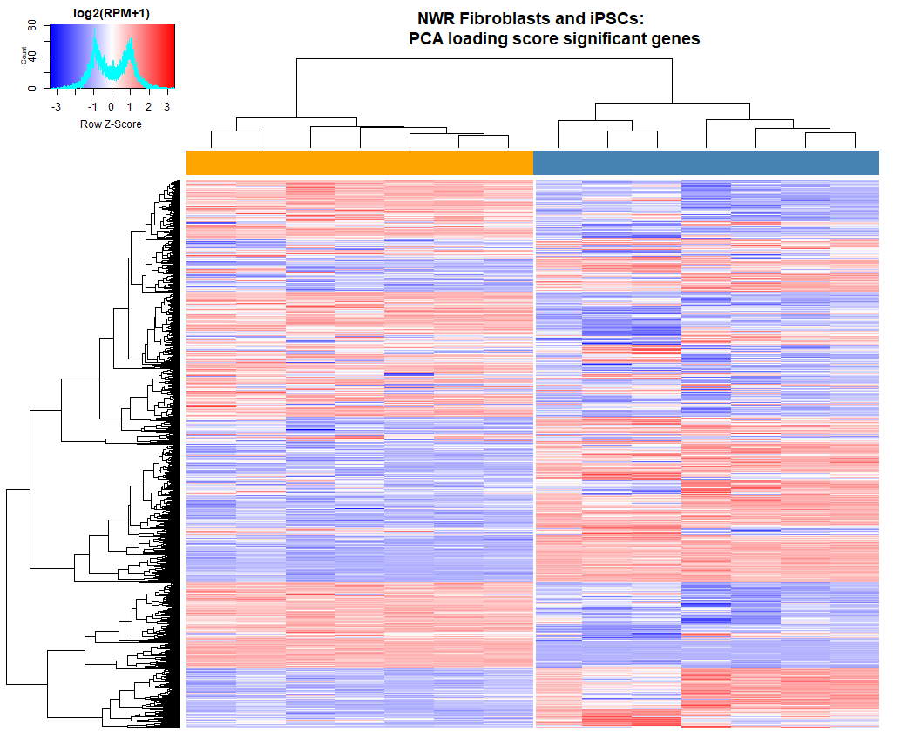
Fibroblasts vs. iPSCs Data
RNAseq
raw counts
Principal Component Analysis (PCA)
Gene Loading Score Scatter Plot
Heatmap & Unsupervised
Hierarchical Clustering
Gene Cluster Ontology Analysis
Notes:
The data I show is from our iPSC to EB experiment
PCA:
Closer = similar, farther = dissimilar
The way each sample position is calculated is by giving each gene a score
Since we’re trying to find the most characterizing genes of a cell type, I plotted all gene scores on a scatterplot and selected for those that scored above 2 SD of the overall mean
~6000 genes selected (5948) that are 2 SD above mean for both PC1 and PC2
Expression heatmap of these 6000
Blue is lowly expressed, red is highly expressed
The heatmap clusters them by UHC
Cut dendrogram into 5 clusters for gene ontology analysis
Put in a list of genes → output biological processes associated with that gene, clustered by how relevant they are in your input

Slide 8
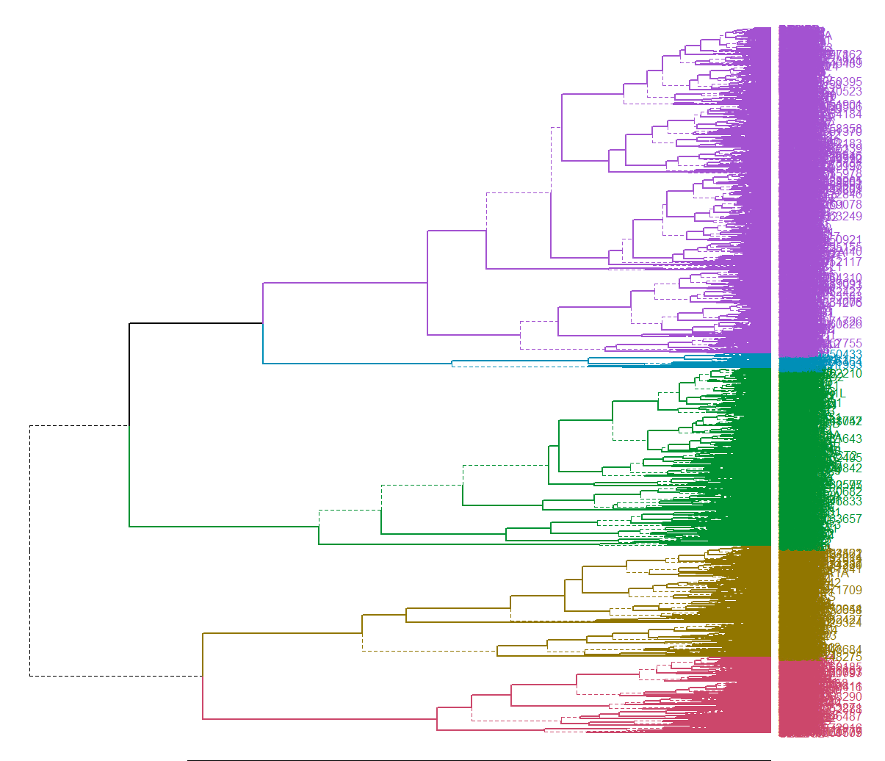
Gene Ontology: Biological Process
Fibroblasts
Cluster 1:
Translational initiation, rRNA processing
Cluster 2:
Cytoskeleton organization, mRNA
iPSCs
Cluster 3:
Cell motion regulation, blood vessel and bone development
Cluster 4:
Mitosis, neural tube formation, neuron development
Cluster 5:
Negative regulation of transcription, blood vessel development
Notes:
AN EXAMPLE OF GENE ONTOLOGY ANALYSIS RESULTS
Listed some of the biological processes

Slide 9
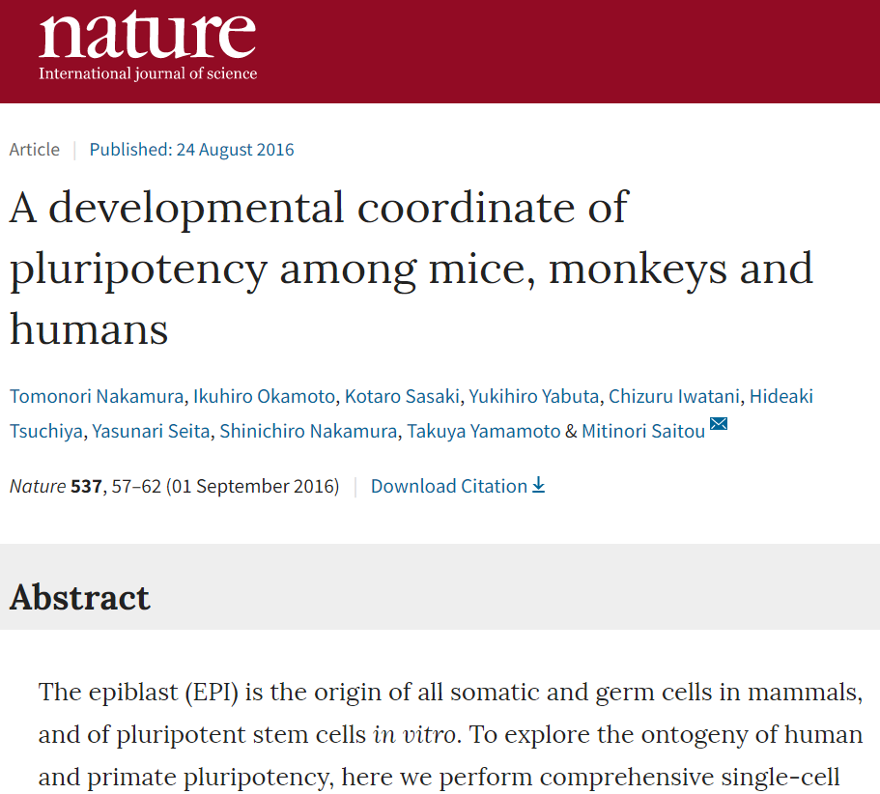
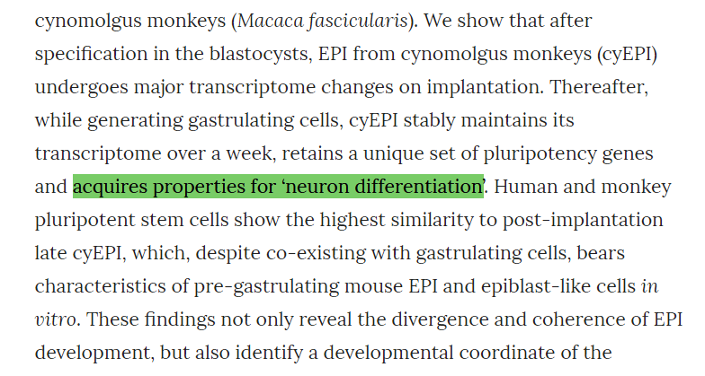
Cluster 4: Neuron development
Fibroblasts
iPSCs
Notes:
AN EXAMPLE OF GENE ONTOLOGY ANALYSIS RESULTS
Listed some of the biological processes

Slide 10



Acknowledgements
Many thanks to:
The Conservation Genetics team
Iñigo Valiente-Alandi Ph.D • Marisa Korody Ph.D • Oliver Ryder Ph.D •
Cythnia Steiner Ph.D • Aryn Wilder Ph.D • Sarah Ford B.S• Tom Nguyen • Claire Caputo
Arnold & Mabel Beckman Foundation
Notes:
WITH THAT I’D LIKE TO THANK
SETUP FOR GABE

